Slide 1
Linked List - Insertion & Deletion
Prepared by: Afaq Mansoor Khan
BSSE III- Group A
Session 2017-21
IMSciences, Peshawar.

Slide 2
Last Lecture Summary
Dynamic Memory Allocation
New Operator
Delete Operator
Heap
dot . and -> operators
Introduction to Linked List
Types
Advantages
Disadvantages
Applications
Difference between Array and Linked List

Slide 3
Objectives Overview
Insertion in Linked List with following criteria
Start of the list
End of the list
Middle of the list
Anywhere in the list
Deletion of a node from
The Tail of the List
The Head of the List
A desired location in the list
Delete node with a particular value

Slide 4
Insertion in Linked List

Slide 5
Insertion
A Node in the Linked List can be inserted at:
Beginning of the list.
End of the list.
Middle of the list
Anywhere in the list

Slide 6
Insertion at the Beginning - Algorithm
Steps to insert a Node at beginning :
Allocate a new node
Insert new element
Have new node point to old head
Update head to point to new node

Slide 7
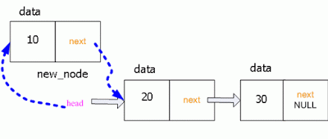

Slide 8
Implementation
int LinkedList :: addAtFront(node *n) {
int i = 0;
//making the next of the new Node point to Head
n->next = head;
//making the new Node as Head
head = n;
i++;
//returning the position where Node is added
return i;
}

Slide 9
Insertion at the End - Algorithm
Steps to insert a Node at End:
Allocate a new node
Insert new element
Have new node point to null
Have old last node point to new node
Update tail to point to new node

Slide 10
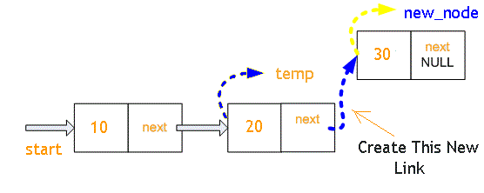

Slide 11
Implementation
int LinkedList :: addAtEnd(node *n) {
if(head == NULL) { //If list is empty
head = n; //making the new Node as Head
n->next = NULL; //making the next pointe of the new Node as Null
}
else {
node *n2 = getLastNode(); //getting the last node
n2->next = n; } }
node* LinkedList :: getLastNode() {
node* ptr = head; //creating a pointer pointing to Head
//Iterating over the list till the node whose Next pointer points to null
//Return that node, because that will be the last node.
while(ptr->next!=NULL) {
//if Next is not Null, take the pointer one step forward
ptr = ptr->next; }
return ptr; }

Slide 12
Insertion at the Middle - Algorithm
Steps to insert a Node at Middle:
Allocate a new node
Insert new element
Go to node that should follow the one to add
Have that node point to the new node
Have new node point to node next node to the found node.

Slide 13
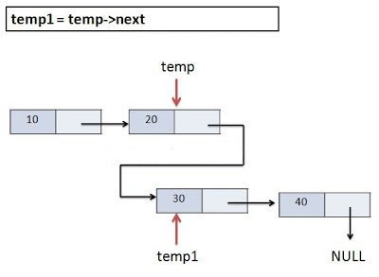

Slide 14
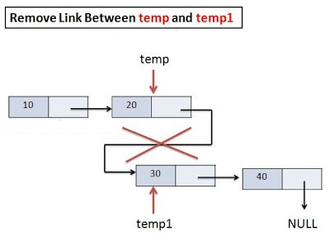

Slide 15
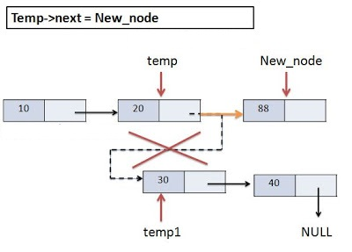

Slide 16
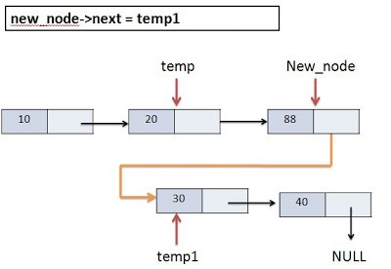

Slide 17
Insertion at a Specific Position - Algorithm
Steps to insert a Node at Specified Position:
Traverse the Linked list up to position-1 nodes.
Once all the position-1 nodes are traversed, allocate memory and the given data to the new node.
Point the next pointer of the new node to the next of current node.
Point the next pointer of current node to the new node.

Slide 18
Implementation
// function to insert a Node at required postion
void insertPos(Node** current, int pos, int data)
{
if (pos < 1 || pos > size + 1)
cout << "Invalid postion!" << endl;
else {
while (pos--) {
if (pos == 0) {
Node* temp = getNode(data);
temp->next = *current;
*current = temp;
}
else
current = &(*current)->next;
}
size++;
}
}

Slide 19
Deletion from Linked List

Slide 20
Deletion
A node in the linked list can be Deleted from:
The Tail of the List
The Head of the List
A Desired location in the list
Delete node with a particular value

Slide 21
Deletion at the Beginning - Algorithm
Steps:
Store Current Start in Another Temporary Pointer
Move Start Pointer One position Ahead
Delete temp i.e. Previous Starting Node as we have Updated Version of Start Pointer

Slide 22
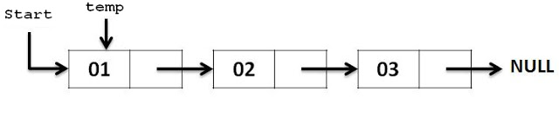

Slide 23
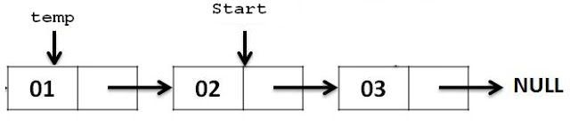

Slide 24
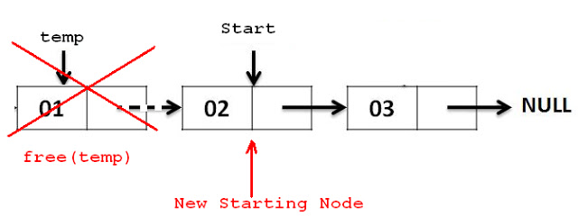

Slide 25
Implementation
Node *removeFirstNode (struct Node* head)
{
if (head == NULL)
return NULL;
// Move the head pointer to the next node
Node *temp = head;
head = head->next;
delete temp;
return head;
}

Slide 26
Deletion at the End - Algorithm
Steps to Delete a Node at End :
Step 1: If FIRST = NULL then Write “Linked List is Empty”
Step 2: If FIRST->LINK = NULL then Return FIRST->INFO FIRST=NULL Else SAVE=FIRST Repeat while SAVE->LINK ≠ NULL PRED=SAVE SAVE=SAVE->LINK Return SAVE->INFO PRED->LINK=NULL
Step 3: Exit

Slide 27
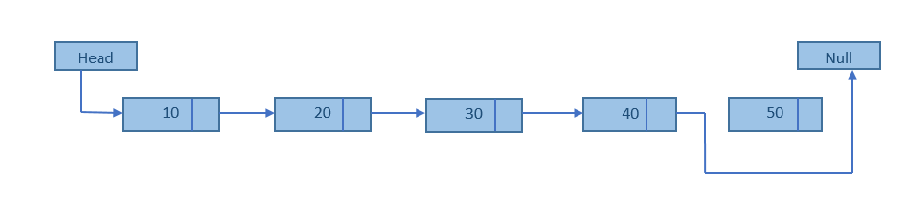

Slide 28
Implementation
Node* removeLastNode(struct Node* head)
{
if (head == NULL)
return NULL;
if (head->next == NULL)
{
delete head;
return NULL;
}
// Find the second last node
Node* second_last = head;
while (second_last->next->next != NULL)
second_last = second_last->next;
// Delete last node
delete (second_last->next);
// Change next of second last
second_last->next = NULL;
return head;
}

Slide 29
Deletion at a Desired Location - Algorithm
Steps:
If start =NULL
Print”over flow”
Return
End if
Set ptr=start
Assign value=start -> info
Set start=start -> next(second node becomes the first node).
Release the node pointed by ptr to the memory heap.
Exit.

Slide 30
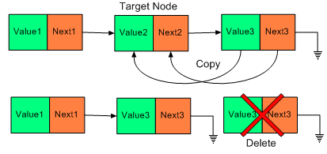

Slide 31
Implementation
void deleteNode(struct Node **head_ref, int position)
{
if (*head_ref == NULL) // If linked list is empty
return;
struct Node* temp = *head_ref; // Store head node
if (position == 0) // If head needs to be removed
{
*head_ref = temp->next; // Change head
free(temp); // free old head
return;
}
for (int i=0; temp!=NULL && i<position-1; i++) // Find previous node of the node to be deleted
temp = temp->next;
if (temp == NULL || temp->next == NULL) // If position is more than number of Nodes
return;
// Node temp->next is the node to be deleted
// Store pointer to the next of node to be deleted
struct Node *next = temp->next->next;
// Unlink the node from linked list
free(temp->next); // Free memory
temp->next = next; // Unlink the deleted node from list
}

Slide 32
Delete Node with a Particular Value - Algorithm
Steps:
Store address of head in a double pointer till we find a non “key” node. This takes care of the 1st while loop to handle the special case of the head.
If a node is not “key” node then store the address of node->next in pp.
If we find a “key” node later on then change pp (ultimately node->next) to point to current node->next

Slide 33
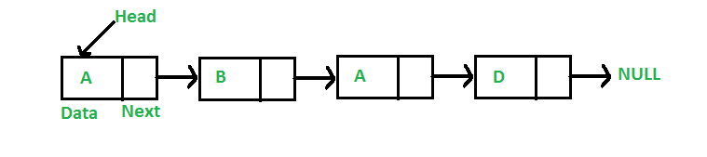

Slide 34
Implementation
void deleteKey(struct Node **head_ref, int key)
{
struct Node* temp = *head_ref, *prev; // Store head node
while (temp != NULL && temp->data == key) // If head node itself holds the key or multiple occurrences of key
{
*head_ref = temp->next; // Changed head
free(temp); // free old head
temp = *head_ref; // Change Temp
}
while (temp != NULL) // Delete occurrences other than head
{
// Search for the key to be deleted, keep track of the
// previous node as we need to change 'prev->next'
while (temp != NULL && temp->data != key)
{
prev = temp;
temp = temp->next;
}
if (temp == NULL) return; // If key was not present in linked list
prev->next = temp->next; // Unlink the node from linked list
free(temp); // Free memory
temp = prev->next; //Update Temp for next iteration of outer loop
}
}

Slide 35
Summary
Insertion in Linked List with following criteria
Start of the list
End of the list
Middle of the list
Anywhere in the list
Deletion of a node from
The Tail of the List
The Head of the List
A desired location in the list
Delete node with a particular value

Slide 36
References
https://www.studytonight.com/data-structures/linear-linked-list
https://www.codelike.in/c/linked-list/
http://www.c4learn.com/data-structure
https://www.slideshare.net/swajahatr/linked-list-c
http://www.thecodegallery.com/DSM/DeleteLast.php
https://www.slideshare.net/sathasivamr1/team-7-42605180

